Slide 1
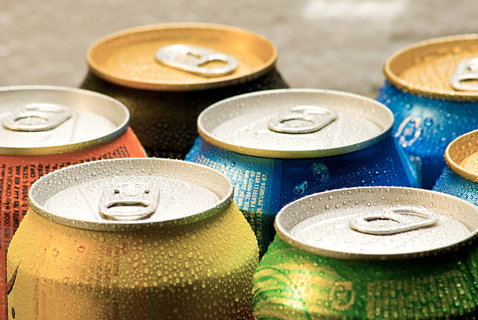
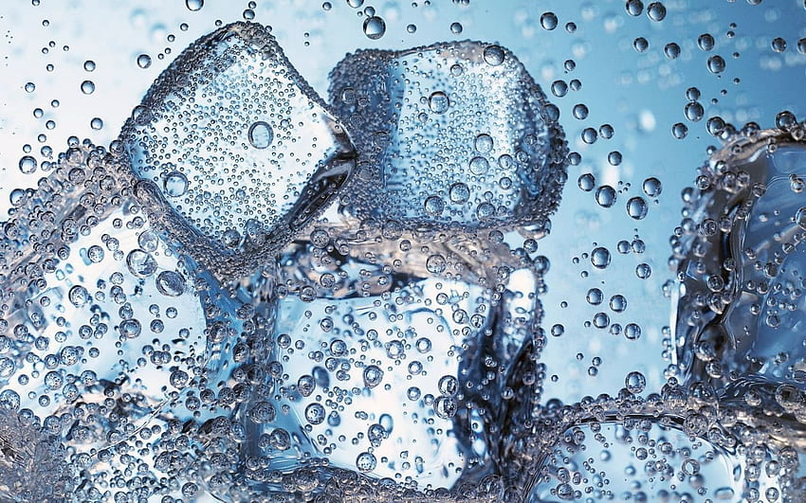
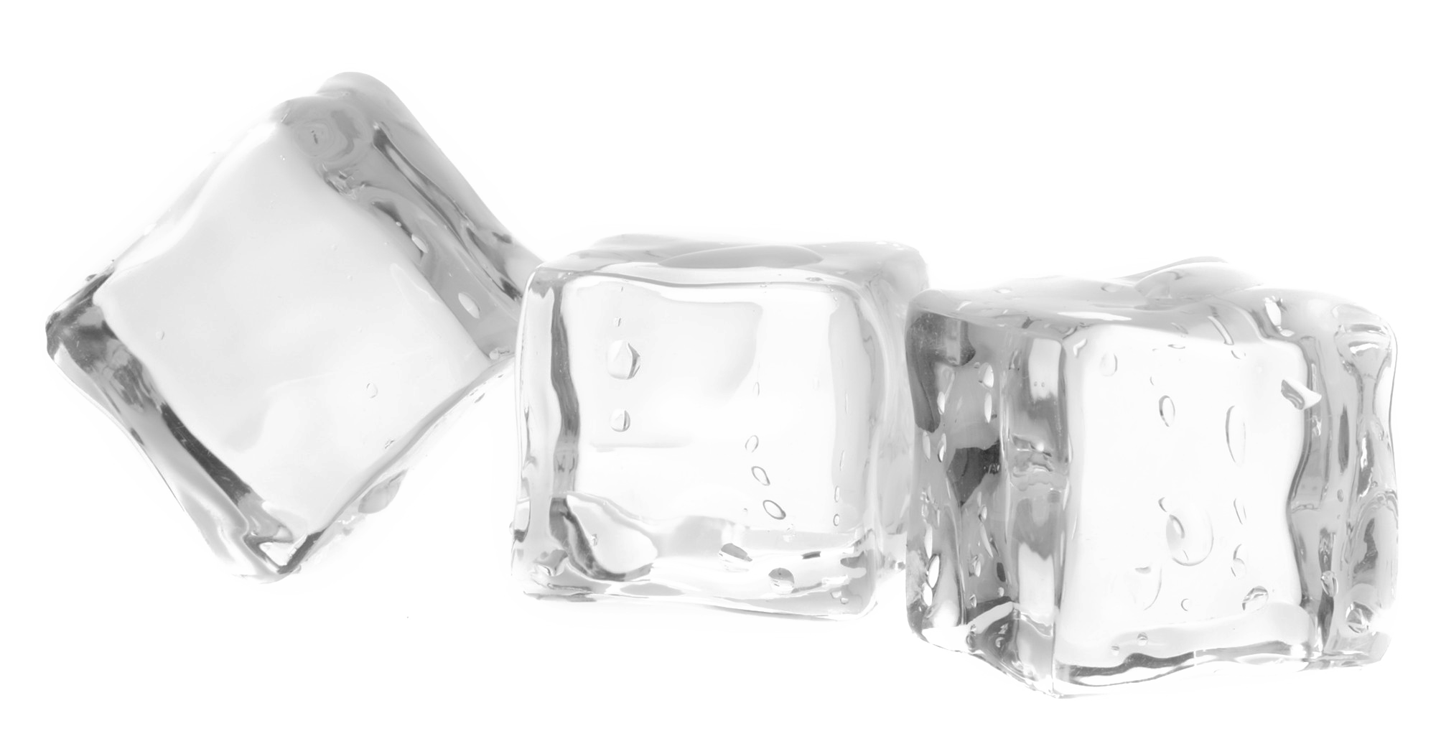
Key Insights to the Marketing Team in Food & Beverage Industry
CodeX
Resume Project Challenge #6 by Codebasics

Slide 2
AGENDA
About CodeX
Problem Statements
Tool Used to Generate Insight
Primary Insights
Demographic Insights
Consumer Preferences
Competition Analysis
Marketing Channels and Brand Awareness
Brand Penetration
Purchase Behavior
Product Development
Secondary Insights
5 Recommendation for Codex
CodeX
(A German Company)
2
Codebasics Resume Project Challenge

Slide 3
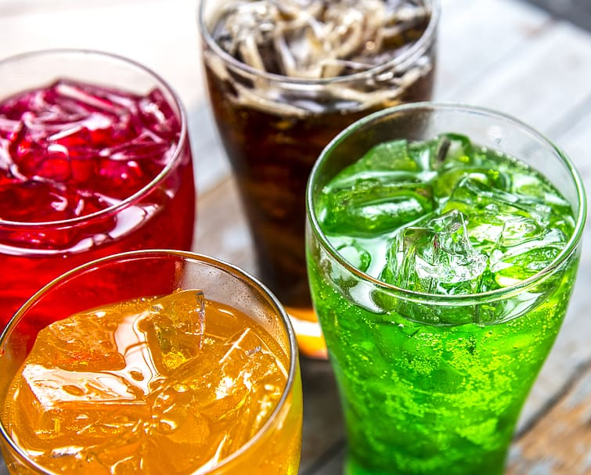
Primary insight
Demographic Insights
Consumer Preferences
Competition Analysis
Marketing Channels and Brand Awareness
Brand Penetration
Purchase Behavior
Product Development

Slide 4
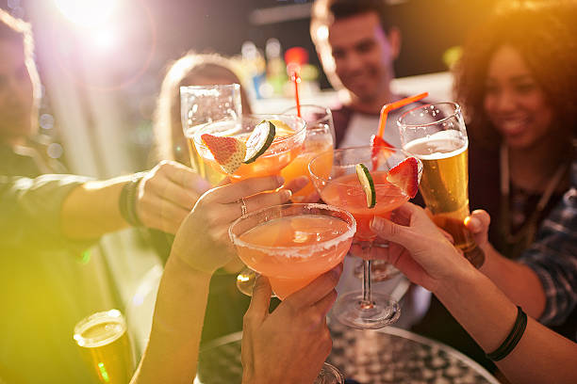
About Us
Domain: F & B
Function: Marketing
CodeX is a German beverage company that is aiming to make its mark in the Indian market. A few months ago, they launched their energy drink in 10 cities of India.
Their Marketing team is responsible for increasing brand awareness, market share, and product development. They conducted a survey in those 10 cities and received results from 10k respondents. Peter Pandey, a marketing data analyst is tasked to convert these survey results to meaningful insights which the team can use to drive actions.
Problem Statement

Slide 5
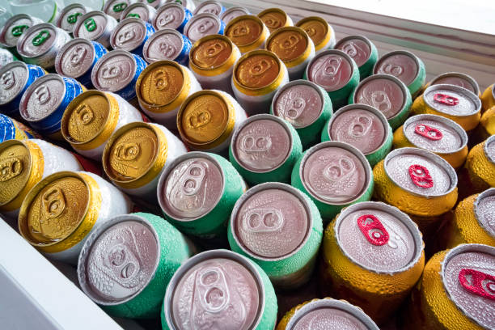




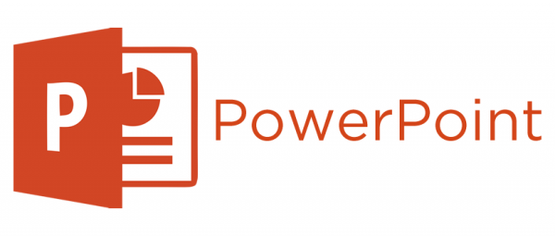
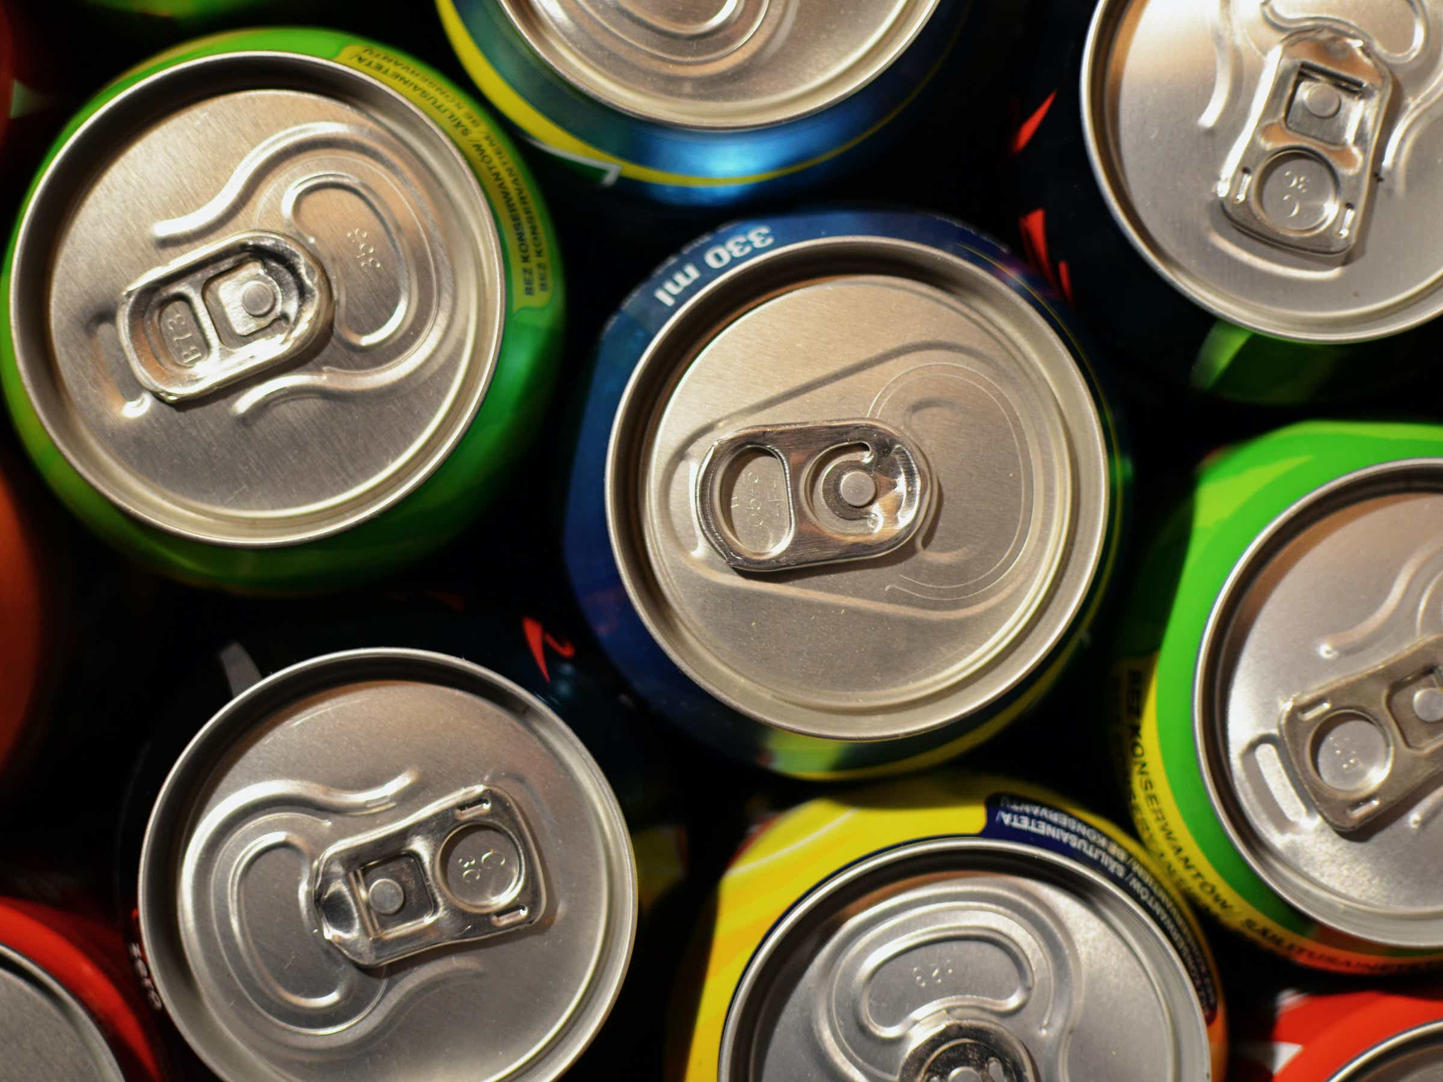





Tool Used to Generate Insight
DATA ANALYSIS
PRESENTATION
CodeX
IMAGE EDITING
(A German Company)
DASHBOARD
VIDEO EDITING

Slide 6
1. Demographic Insights
Who prefers energy drink more?
Which age group prefers energy drinks more?
Which type of marketing reaches the most Youth (15-30)?
60%
Age Group (15-30)
35%
5%
Male are consuming more drink compare to female and non-binary.
Out of 10,000 responses we received, in which 60% male, 35% female and 5% non-binary gender are consuming drink in India.
Young adults, typically in the age range of 19-30 are the most consumers of energy drinks. This may includes working professional, students and sports person.
The age group of 46+ is the least likely to consume energy drinks.
Online ads have shown the highest reach and popularity compared to other modes of marketing advertisement.
Print media is the least popular mode of marketing hence company can make strategy on this and take action.

Slide 7
2. Consumer Preferences
What are the preferred ingredients of energy drinks among respondents?
What packaging preferences do respondents have for energy drinks?
According to survey result, Caffeine and Vitamins are the most preferred energy drinks amongst other category.
Caffeine and Vitamins drinks also known as Energy or Caffeinated drink which is so popular as have lots of flavor available in the market also its boost the energy, combat the fatigue & boost sportsman performance.
Compact and portable cans packaging category is on top because of its portability and easy to open. Cans and portable bottles can enhance overall drinking experience and comfortably fit in the hand and provide a better grip.
Innovative bottle design is 2nd preference by consumer as it help brands to attract consumer with his ergonomic shape and design.

Slide 8
3. Competition Analysis
Current Market Leader
Cola-Coka
Cola-Coka
Bepsi
Gangster
1
2
3
The energy drink market is highly competitive and dynamic with several major players however Cola-Coka is the market leader Globally and has a strong presence in India.
Bepsi is another major player in the Indian beverage market. They manufacture and distribute a variety of beverages, including carbonated soft drinks, juices and sports drinks.

Slide 9
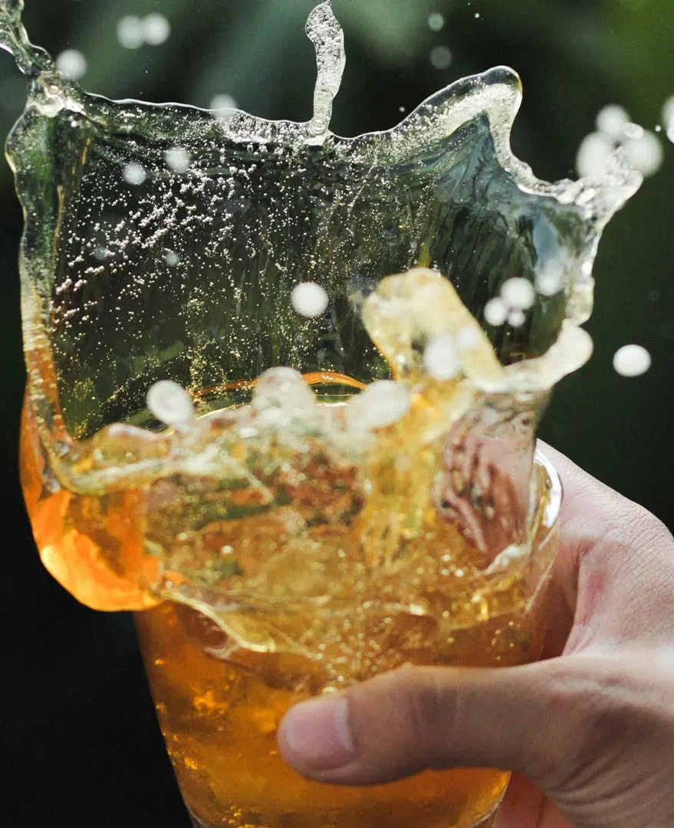

3. Competition Analysis
What are the primary reasons consumers prefer those brands over ours?
Brand Reputation play a significant role in consumer preferences. In beverage industry Taste / Flavor is also one of the crucial factor for consumer.
Established brands like ’Cola-Coka, Bepsi, Gangster and many other brands have a long-standing presence in the Indian and Global market and associated a strong trust for the consumer.
Key insights

Slide 10
4. Marketing Channels and Brand Awareness
Which marketing channel can be used to reach more customers?
How effective are different marketing strategies and channels in reaching our customers?
India is 2nd largest internet users after China, Online ads are a popular and effective marketing channel for reaching a wide audience.
Running online ads on platforms like Google, YouTube, social media, and OTT app platforms can indeed help marketing teams spread brand awareness from urban to rural areas.
Online Ads and TV commercials should be primarily focused as a marketing strategies to reach customer and focus on below 3 categories more:
Age Group 15-30+;
Online and TV ads ;
Male and Female.

Slide 11
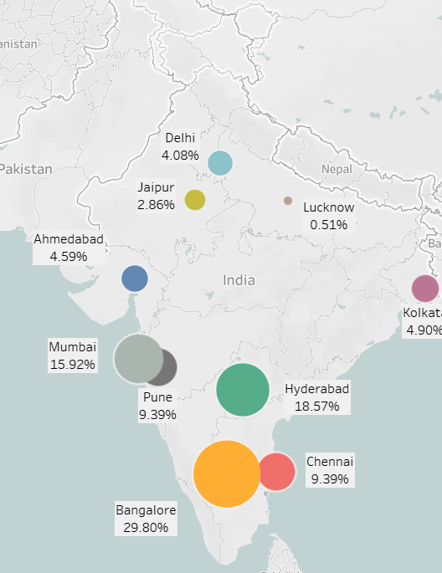
5. Brand Penetration
What do people think about our brand?
Which cities do we need to focus more on?
Very good consumption in Tier 1 cities specially in Bangalore, Hyderabad and Mumbai.
Team need to more focus on Chennai, Kolkata, Delhi and Jaipur and do promotion as much as possible. Expand the distribution networks or proximity to manufacturing facilities. This can help streamline operations and ensure timely delivery to customers.
As CodeX is new in the market so might be chance to get negative feedback because unfamiliar with the brands and taste. While 22% of consumers provided Positive feedback which indicates some level of satisfaction.
60% of consumer are unsure about Codex or not willing to provide feedback hence Marketing team to think that how can convert neutral feedback to more positive feedback.

Slide 12
6. Purchase Behavior
Where do respondents prefer to purchase energy drinks?
What are the typical consumption situations for energy drinks among respondents?
What factors influence respondents' purchase decisions, such as price range and limited edition packaging?
Supermarkets typically offer a wide range of products. People go for grocery and pick the energy drinks from there because of best deal compare to other mode.
Online retailers is on 2nd place and most of the tier 1 city is more demanding on it.
Athletes and gym enthusiastic engaged in physical activities often use energy drinks to enhance their performance.
Student and working professional also use energy drinks which helps them push through fatigue and complete their tasks.
Price is a significant consideration for many consumers, As per the survey result Price range of 50-99 & 100-150 received mix of responses. But here marketing team need to think about how to convert negative response to more positive.

Slide 13
7. Product Development
Which area of business should we focus more on our product development? (Branding/taste/availability)
Codex
Branding
Availability
Taste
1
2
3
525 (54%) consumer are not aware about our brands which means Marketing Team to focus on branding part first as branding plays a significant role in establishing a unique identity for your product and connecting with consumers. Strong branding can helps to create brand loyalty as well.
1
As per the survey result 233 users deny to taste our product because of ‘Health concerns’ and 210 users are not interested in ‘Energy Drinks’ but if we focus on these 2 factors “Not availale locally” and “Unfamiliar with brands” which marketing team should more focus on.
2
Developing a product with exceptional taste, flavor, or aroma can differentiate your offering from competitors and lead to customer satisfaction and loyalty.
3

Slide 14
Recommendations for CodeX:
What immediate improvements can we bring to the product?
30%
QUALITY ENHANCEMENT:
The very first improvement which need to be consider are ‘Reduced Sugar Content’ and include more ‘Natural ingredients’ & ‘More flavors’ as people are health conscious and need variety of flavor without preservatives.
Evaluate your product recipes and explore opportunities to reduce the sugar content without compromising taste and quality. Consider using alternative sweeteners such as stevia, monk fruit extract, or erythritol, which can provide sweetness with fewer calories.
Explore Natural Alternatives: Review your product's ingredient list and identify any artificial or processed ingredients that can be replaced with more natural alternatives. Research natural flavorings, colorings, and preservatives that align with your product's taste and quality requirements.
Highlight Health Benefits: Emphasize the reduced sugar content and the use of natural ingredients as part of your product's marketing and packaging. Educate consumers about the health benefits associated with these changes, such as lower sugar intake, fewer artificial additives, and the use of recognizable, natural ingredients. Clear and transparent communication can help build trust and attract health-conscious consumers.
24%
21%
15%
10%
BRAND PROMOTION: AWARENESS ABOUT HEALTH BENEFITS WITH ENERGY DRINKS
Highlight Health Benefits: Emphasize the reduced sugar content and the use of natural ingredients as part of your product's marketing and packaging.
Educate consumers about the health benefits associated with these changes, such as lower sugar intake, fewer artificial additives, and the use of recognizable, natural ingredients.
Collaborate with Health Professionals: Partner with healthcare professionals, nutritionists, or public health organizations to disseminate accurate information and promote responsible energy drink consumption.

Slide 15
Recommendations for CodeX:
What should be the ideal price of our product?
Cost Analysis
Price is a significant consideration for many consumers, Price range of 50-99 & 100-150 received mix of responses and consumer prefer that the price should be 50-99Rs.
Calculate your production costs, including raw materials, labor, manufacturing, packaging, and overhead expenses and then compare your competitive market price and keep less price also provide offer for additional purchase.
Expanding distributor network and providing them with additional benefits can be an effective strategy to increase your product's reach and drive sales in the local market.
What kind of marketing campaigns, offers, and discounts we can run?
Re-targeting of Ads
Right Audience Target: Over 500 millions users are on Social Media in India, clearly identify the demographics, interests and behaviors of your ideal customers, considering age, gender, location and fitness interest and provide them offer such as ‘Redeem Code’ which they can use on nearest store.
Referral programs: Launch a referral program where existing consumer may get cashback, rewards, discounts or exclusive benefits to customers who refer new product.
Tie up with fitness App/Center: Tying up with fitness apps or fitness centers can be a beneficial strategy to promote your energy drink. Keep your product on main counter so consumer first eye go on your product. Send Codex Representative to the center who can make the consumer and promote the brands.
Buy-One-Get-One (BOGO) Offer: Encourage customers to purchase by offering a buy-one-get-one free or buy-one-get-one at a discounted price promotion. This incentivizes customers to try your energy drink and increases the value they receive from their purchase.
Free Bottle gift with purchase: Offer free bottle with first purchase, can keep a minimum cart amount. A consumer may get happy and promote the brands more.
Free Home Delivery / 10 Min delivery App: Target this kind of app and promote your brands this such app.

Slide 16
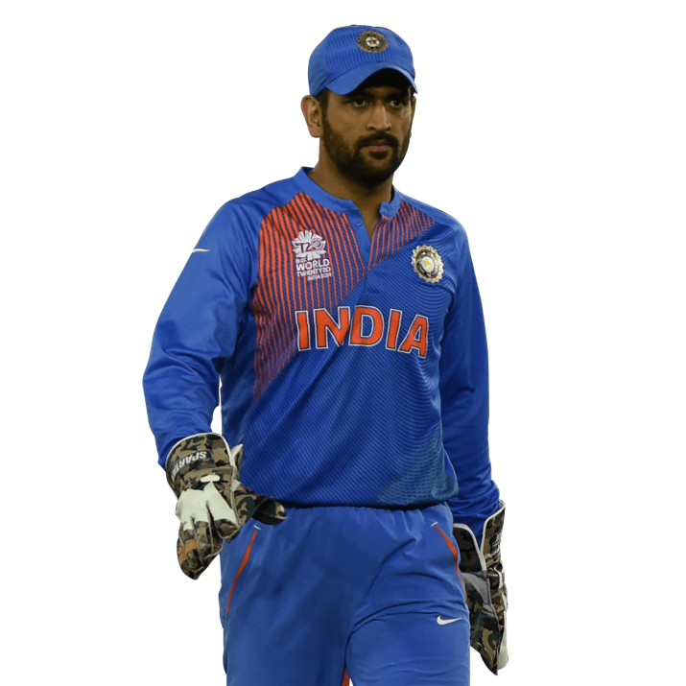
Recommendations for CodeX:
Who can be a brand ambassador, and why?
MAHENDRA SINGH DHONI
Selecting Mahendra Singh Dhoni as brand ambassador for energy drink can be a suitable choice. Here are a few reasons why he could be a suitable choice:
Strong Brand Image: Mahendra Singh Dhoni, popularly known as MS Dhoni, has a strong and positive brand image in India. Associating your energy drink with Dhoni's brand image can help enhance your brand's reputation and credibility.
Fan following in millions: Dhoni has a massive fan following, not only in India but also globally. His popularity extends beyond cricket enthusiasts, attracting a diverse audience. Leveraging his fan base can significantly increase brand visibility and reach among your target audience.
Role Model Status: Dhoni is considered a role model by many, including aspiring athletes, cricket enthusiasts, and the youth. His association with your brand can inspire and influence your target audience to choose your energy drink as a trusted companion for their fitness and performance goals.
Brand Awareness: Dhoni's high-profile presence and media visibility can help generate significant brand awareness for your energy drink. His endorsement can attract attention from both traditional media outlets and social media platforms, leading to increased brand recognition.

Slide 17
Recommendations for CodeX:
Who should be our target audience, and why?
Gamers and sports Enthusiasts
Targeting individuals who are actively engaged in sports, fitness activities, or regular exercise is a common approach for energy drinks. This audience seeks products that can enhance their performance, provide a boost of energy, and aid in post-workout recovery.
Student / Working professional
Energy drinks are often consumed by students and young professionals who need a quick pick-me-up to stay focused, alert, and productive. This audience may appreciate the energy-boosting properties of your drink during long study or work sessions.
Health-Conscious Consumers
Targeting health-conscious individuals who prioritize clean and natural ingredients can be effective. Emphasize the use of natural or organic ingredients, reduced sugar content, and other health benefits to resonate with this audience.
CodeX
(A German Company)
Youth (Male & Female)
Youth (15-30 age) should be a target for as the often seeks energy-boosting products to support their active lifestyles, academic commitments, and social engagements.
Tier 1 / Tier 2 Cities
Tier 1 city like Pune, Delhi, Kolkata have higher popular density and a larger consumer market, targeting these cities can provide access to significant number of potential customer, increasing the reach and sales of your energy drink.

